Slide 1
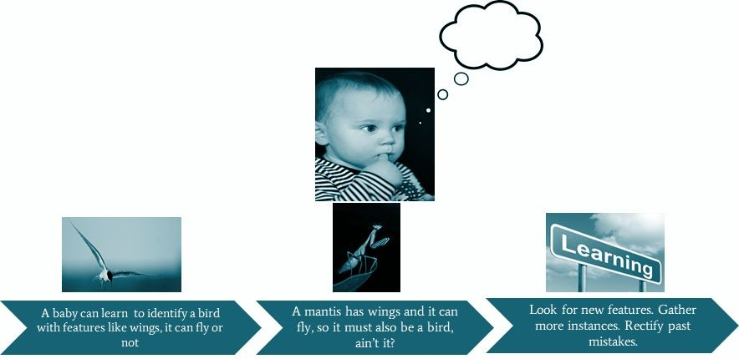
Introduction to Machine Learning
How do humans learn?

Slide 2
Machine Learning
Learning is any process by which a system improves performance from experience
Machine learning is concerned with a computer program that automatically improve their performance through experience

Slide 3
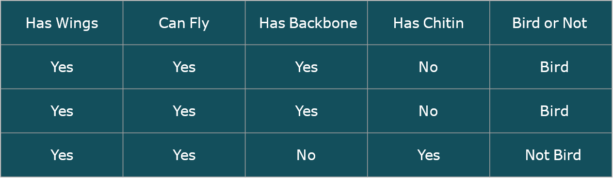
Bird Classiﬁcation
Dependent Variable
Features/Input Variables

Slide 4
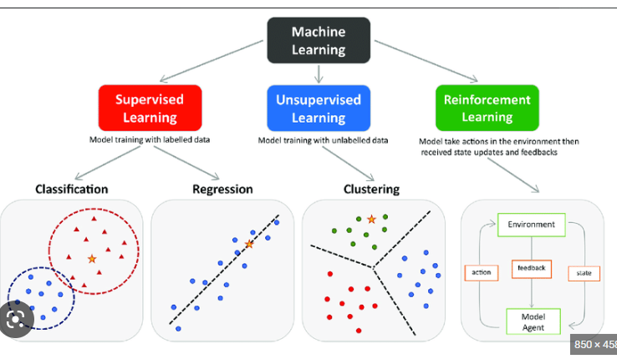
Tasks in Machine Learning:

Slide 5
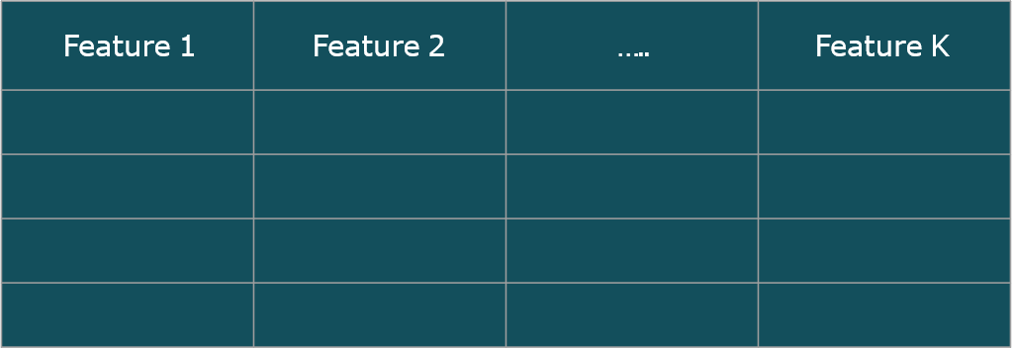
Unsupervised Learning
No Dependent variable

Slide 6
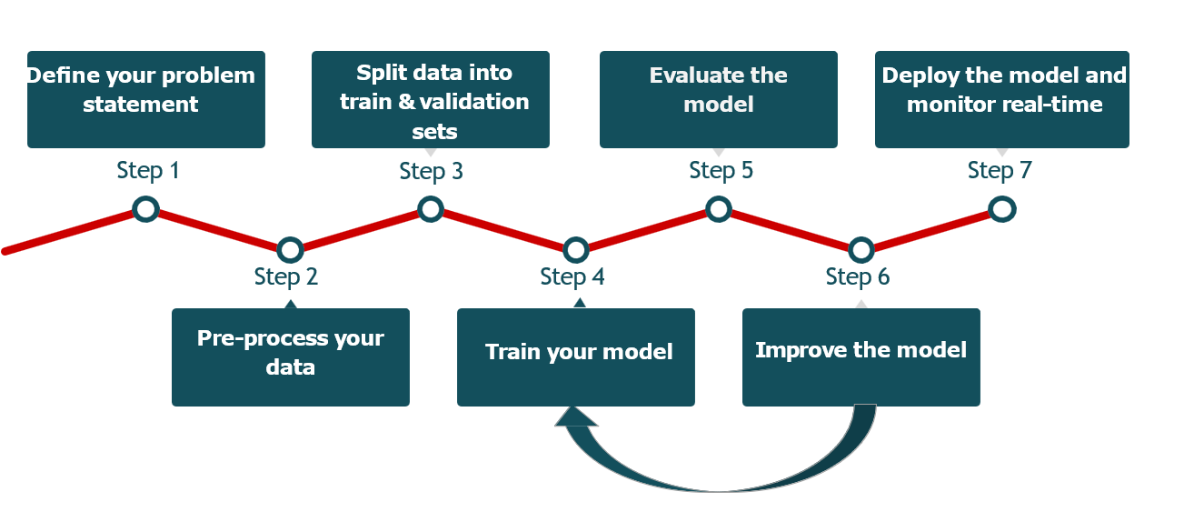
Steps in Supervised ML Modeling:

Slide 7
Linear Regression

Slide 8
We will talk about...
Introduction
Hypothesis of linear regression
Assumption of regression
Properties of the regression line
Advantages of linear regression
Limitations of linear regression
Data preparation for linear regression
Regression Model Evaluation Metrics

Slide 9

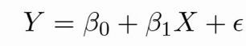
Introduction
Linear regression is one of the most basic types of regression in supervised machine learning. The linear regression model consists of a predictor variable and a dependent variable related linearly to each other. We try to ﬁnd the relationship between the independent variable (input) and a corresponding dependent variable (output).
This can be expressed in the form of a straight line
Linear regression, also known as ordinary least squares (OLS) and
linear least squares, is the real workhorse of the regression world.

Slide 10
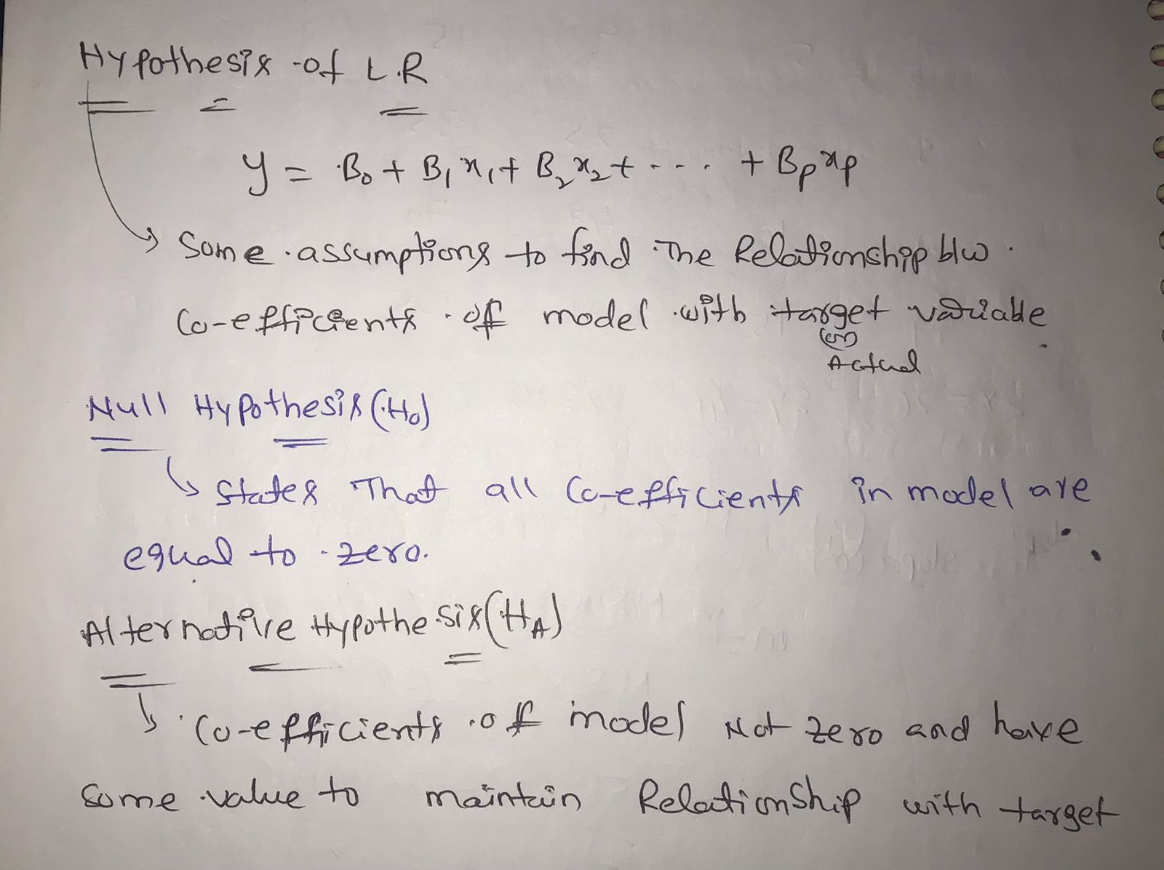
Hypothesis of Linear Regression

Slide 11
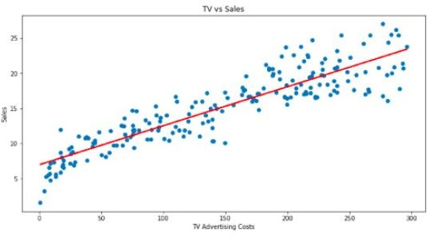
R O I OF TV ads?
Looking at the past investment in TV ads vs Sales done by the company. Company wants to estimate the return on investment (ROI) which can be calculated by estimating sales through past investments on TV ads.
The goal of linear regression is to create
a trend line or best ﬁt line based on the
past data of investment on TV ads vs Sales.
Trend line which can then be used to
conﬁrm or deny the relationship whether
TV ads create impact on Sales and also
predict Sales based on TV ads

Slide 12
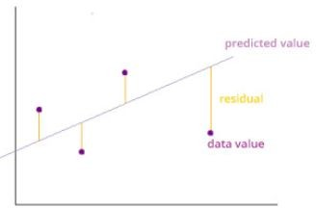
How do we determine the best ﬁt line?
The best ﬁt line is considered to be the line for which the error between the predicted values and the observed values is minimum.
It is also called the regression line and the errors are also known as residuals.
It can be visualized by the vertical lines from the observed data value to the regression line.
min(SSE) =
SSE : Sum square error

Slide 13
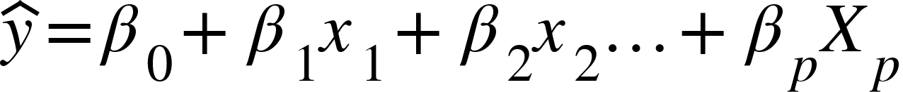
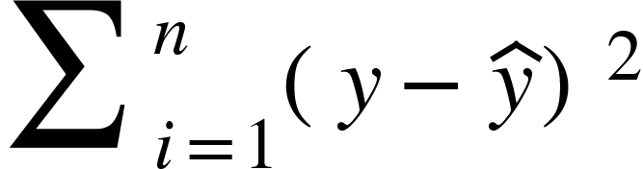
Predicted Output?
Linear regression equation without error term gives predicted output
By varying different parameter values (𝛃_{p}) , predicted value can be determined and value which gives minimum SSE will produce the best fit line
Note: Predicted value can have positive or negative error. If we don’t square the error, then the positive and negative points will cancel each other out. Absolute function(
|Actual- Pred| ) can be one option but it is not differentiable at Actual = Pred
SSE :

Slide 14
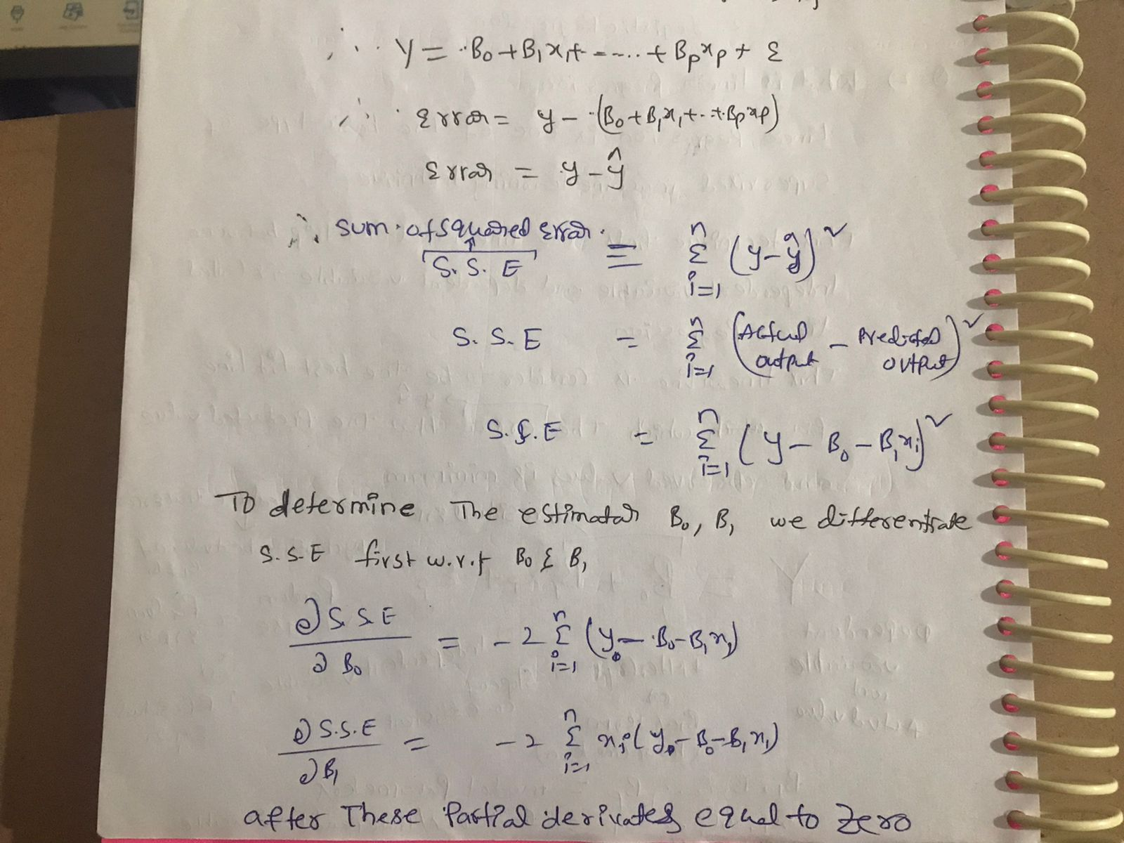

Slide 15
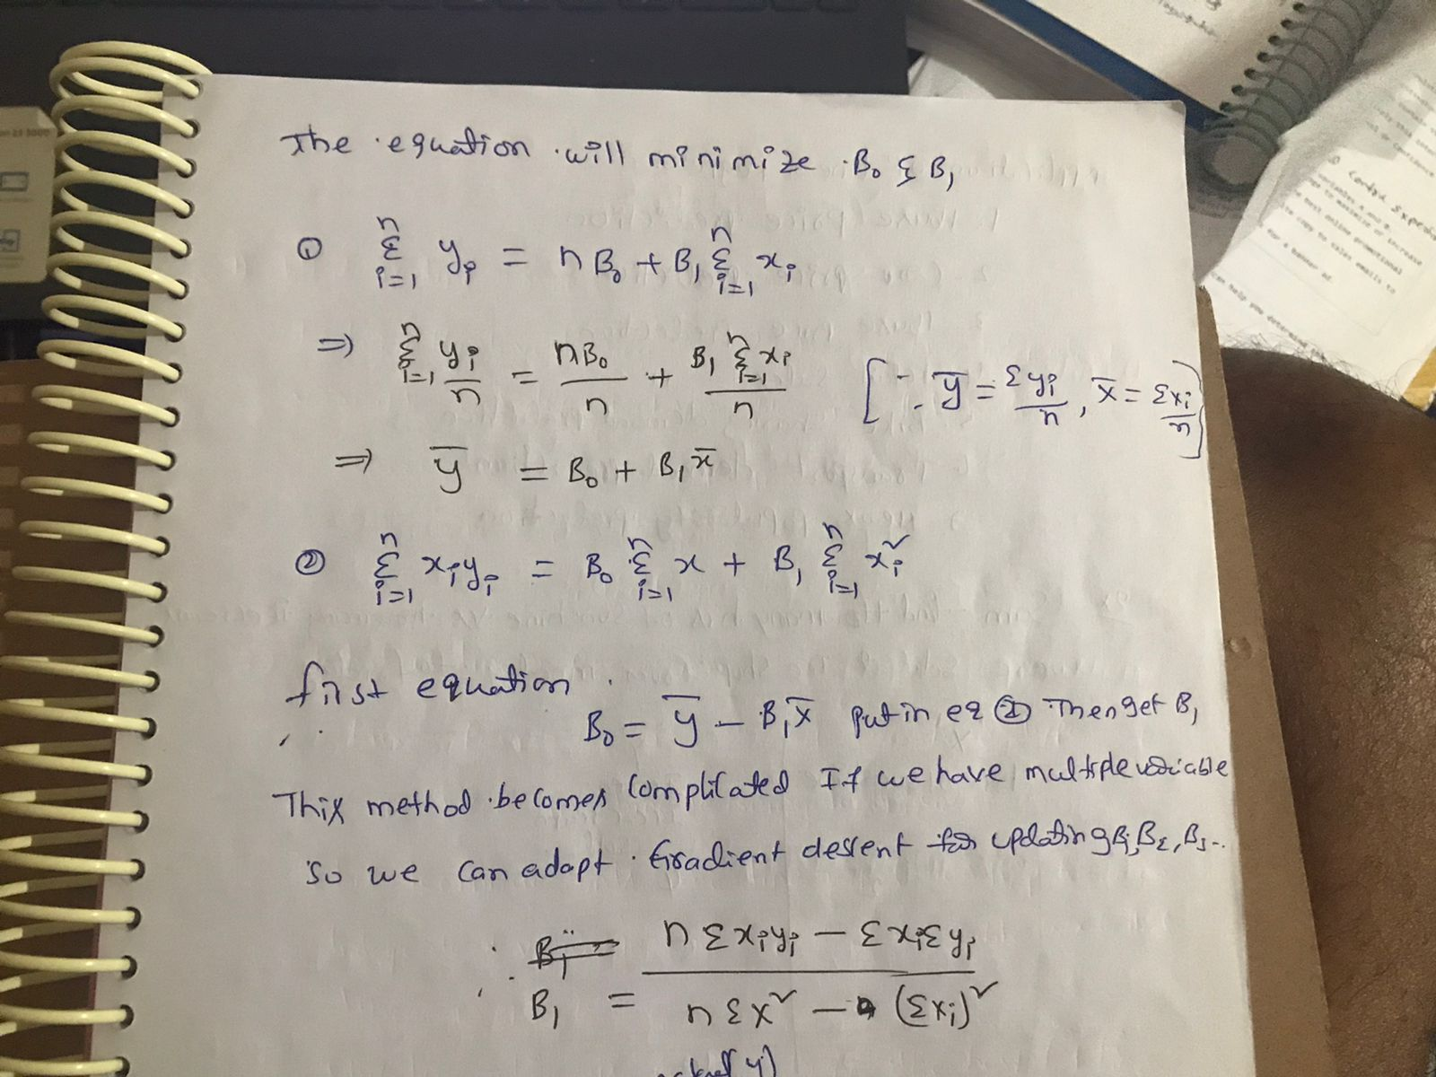

Slide 16
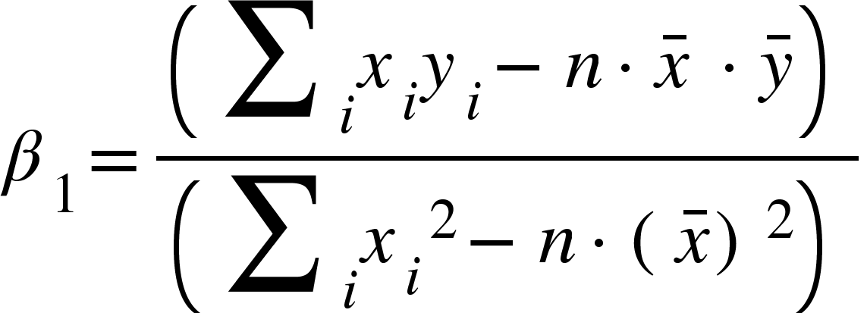
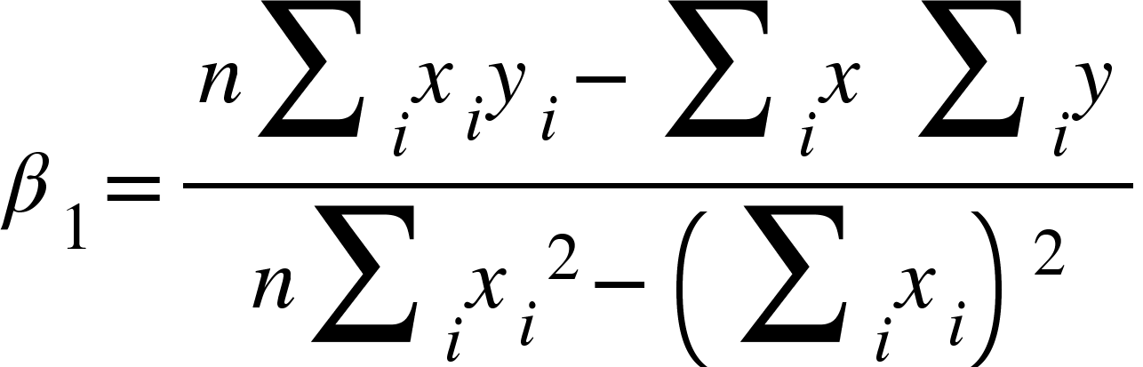

Slide 17
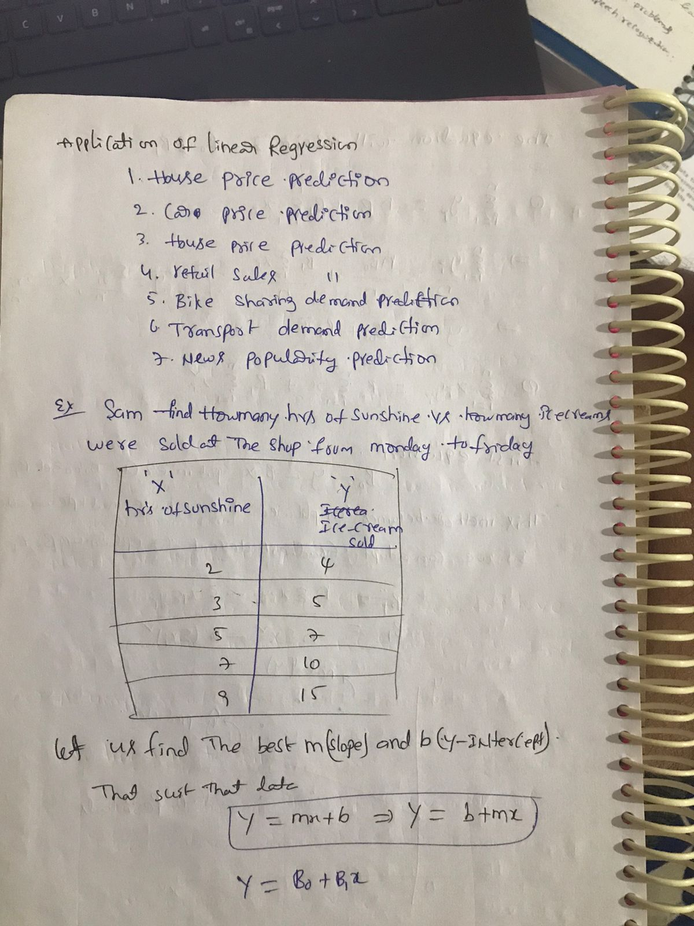

Slide 18
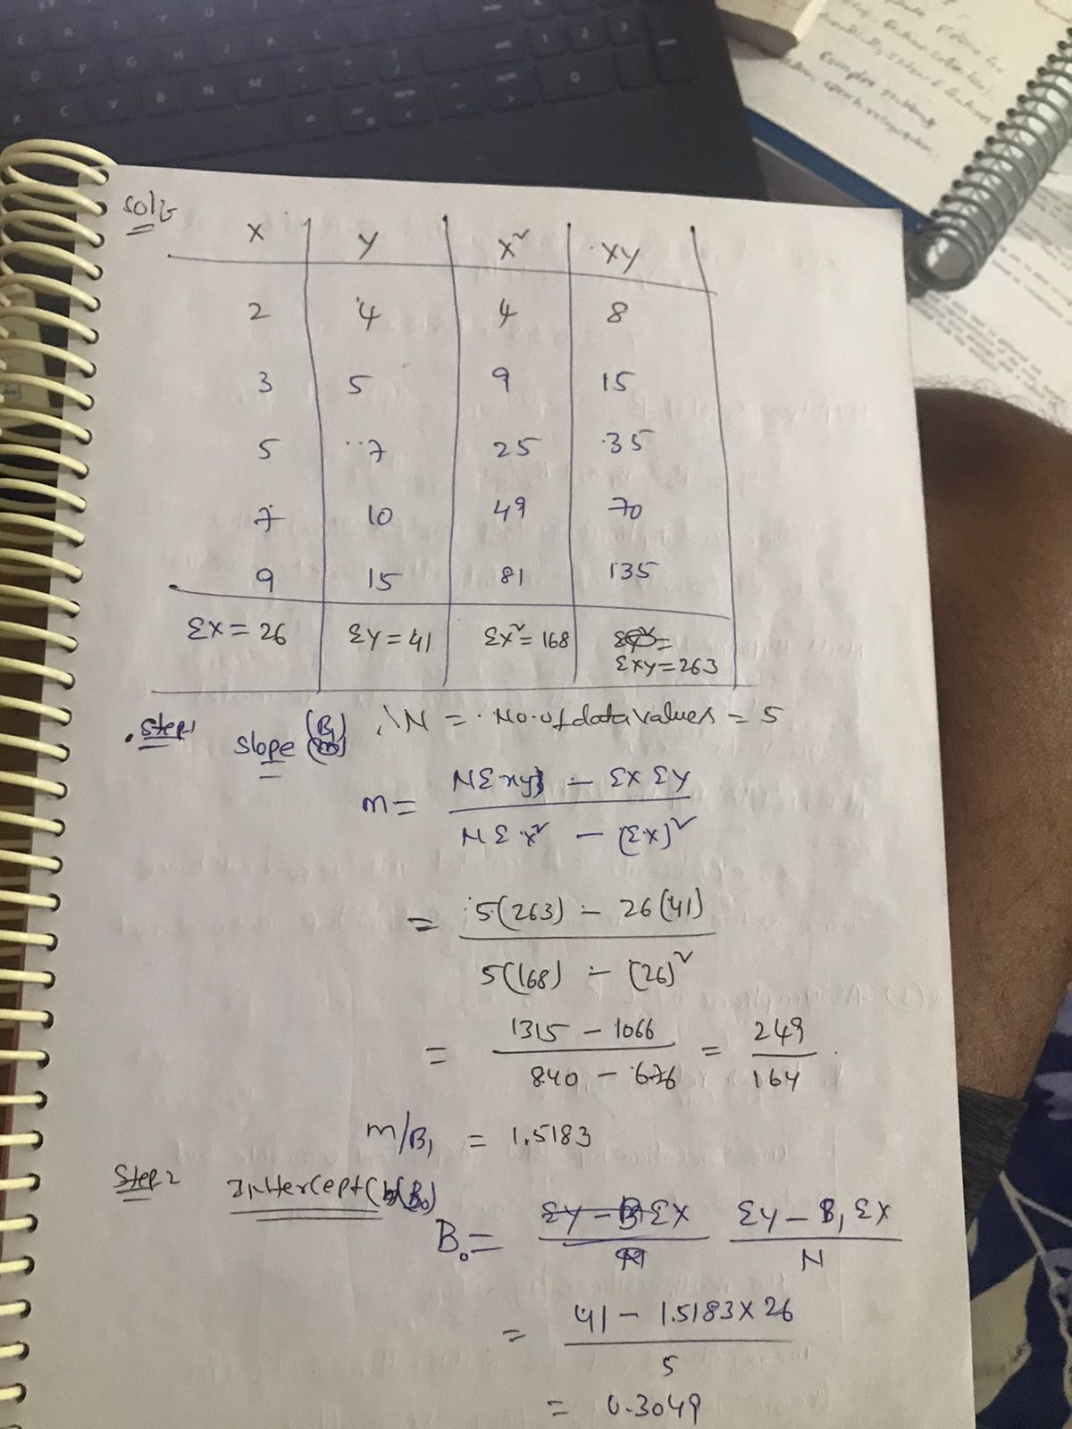
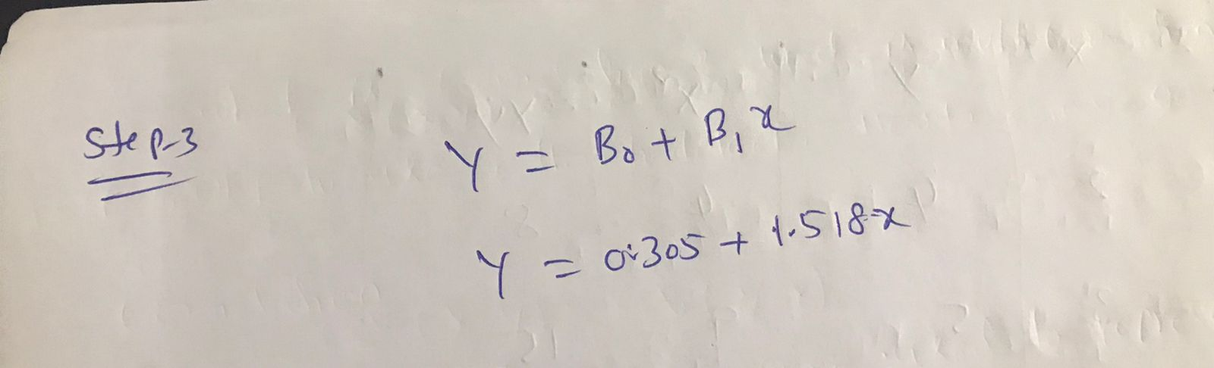
Notes:
https://www.kdnuggets.com/2018/07/why-machine-learning-project-fail.html

Slide 19
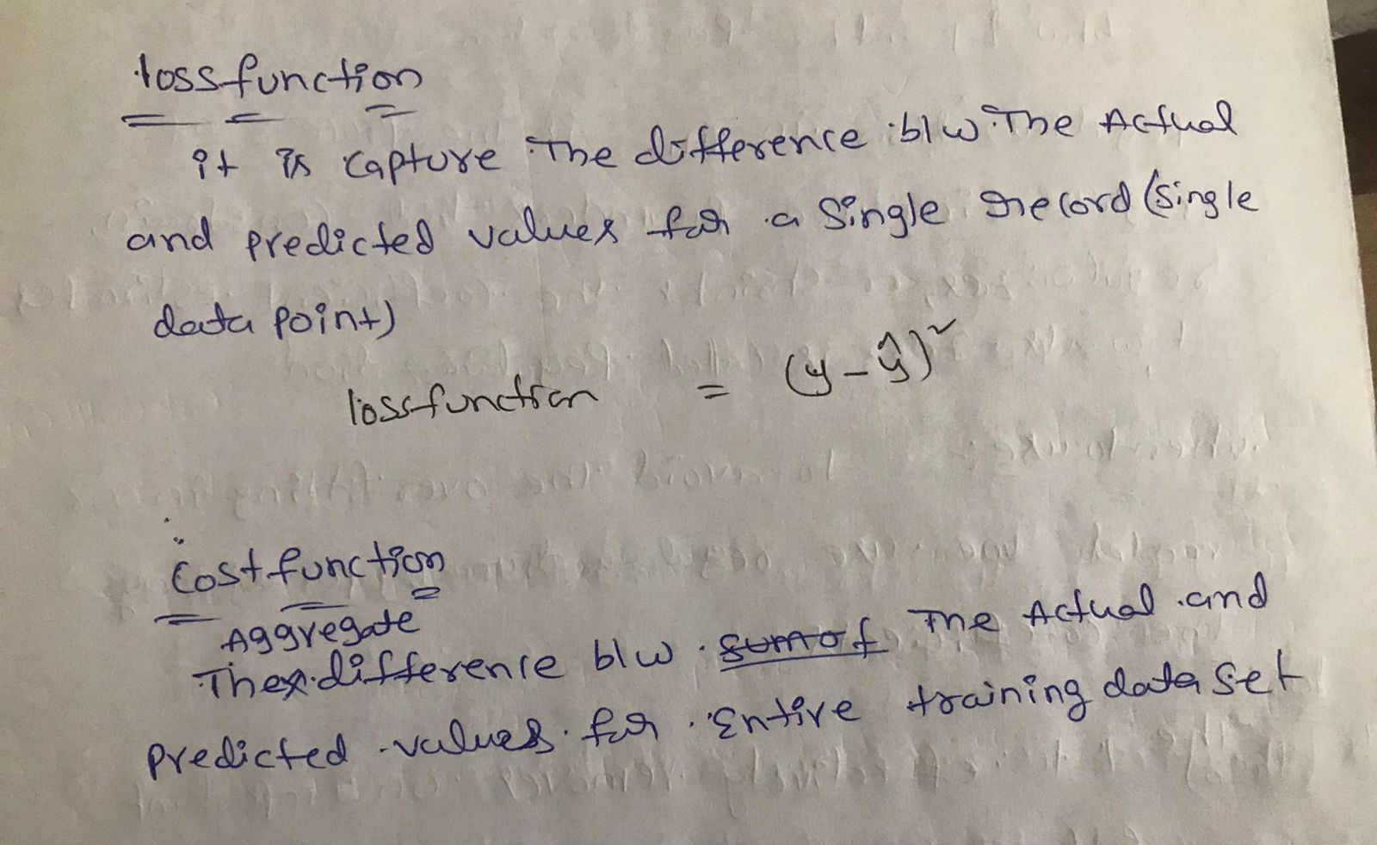
Best possible 𝛽_{p}
With inﬁnite possibilities of values which parameter can take, how do we arrive at the best possible 𝛽_{p} with minimum iteration.
Gradient Descent is an optimization algorithm that helps machine learning models to ﬁnd out paths to a minimum value using repeated steps.
Gradient descent is used to minimize a function so that it gives the lowest output of that function. This function is called the Loss Function

Slide 20
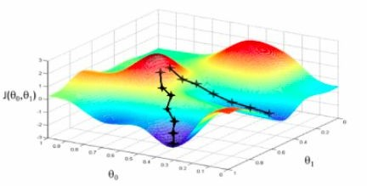
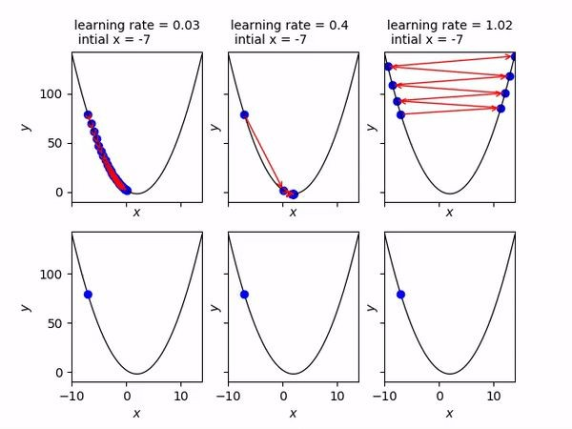
Gradient Descent
Let us relate gradient descent with a real-life analogy for better understanding. Think of a valley you would like to descend when you are blind-folded. Any sane human will take a step and look for the slope of the valley, whether it goes up or down. Once you are sure of the downward slope you will follow that and repeat the step again and again until you have descended completely (or reached the minima)

Slide 21
Learning Rate(𝛂)
The learning rate (the size of the adjustments made) is an important hyper-parameter to set carefully.
In practice, it’s better to keep the learning rate small. However, too small and it would take a long to descend toward the global minima. Too large, however, and it may overshoot the global minimum altogether, or even diverge away from it (thus increasing the error).

Slide 22
Exploring β
β_{p} :
If β_{p} > 0, then x (predictor) and y(target) have a positive relationship. That is an increase in x will increase y.
If β_{p} < 0 then x (predictor) and y(target) have a negative relationship. That is an increase in x will decrease y.
β₀ :
The value of β₀ guarantees that the residual will have mean zero. If there is no β₀term, then the regression will be forced to pass over the origin.
Both the regression coefﬁcient and prediction will be biased.

Slide 23
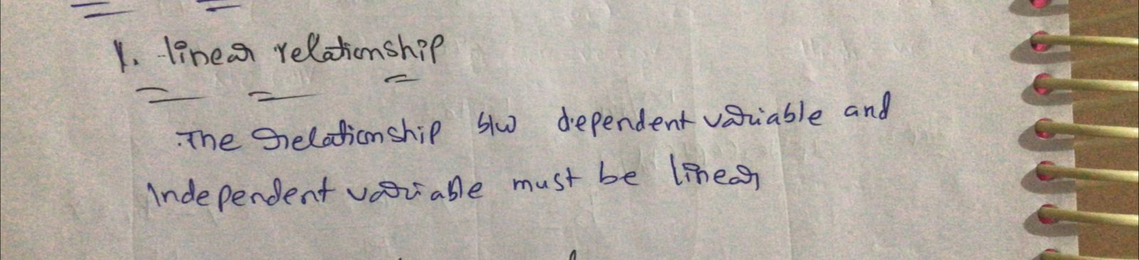
Assumption of Linear regression

Slide 24
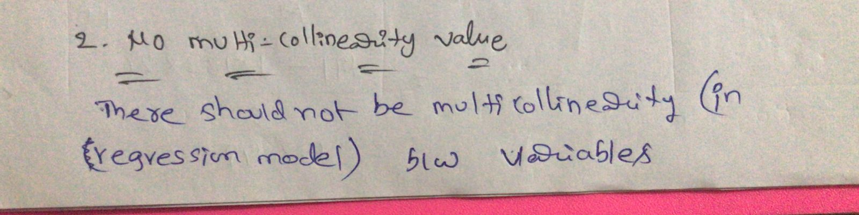

Slide 25
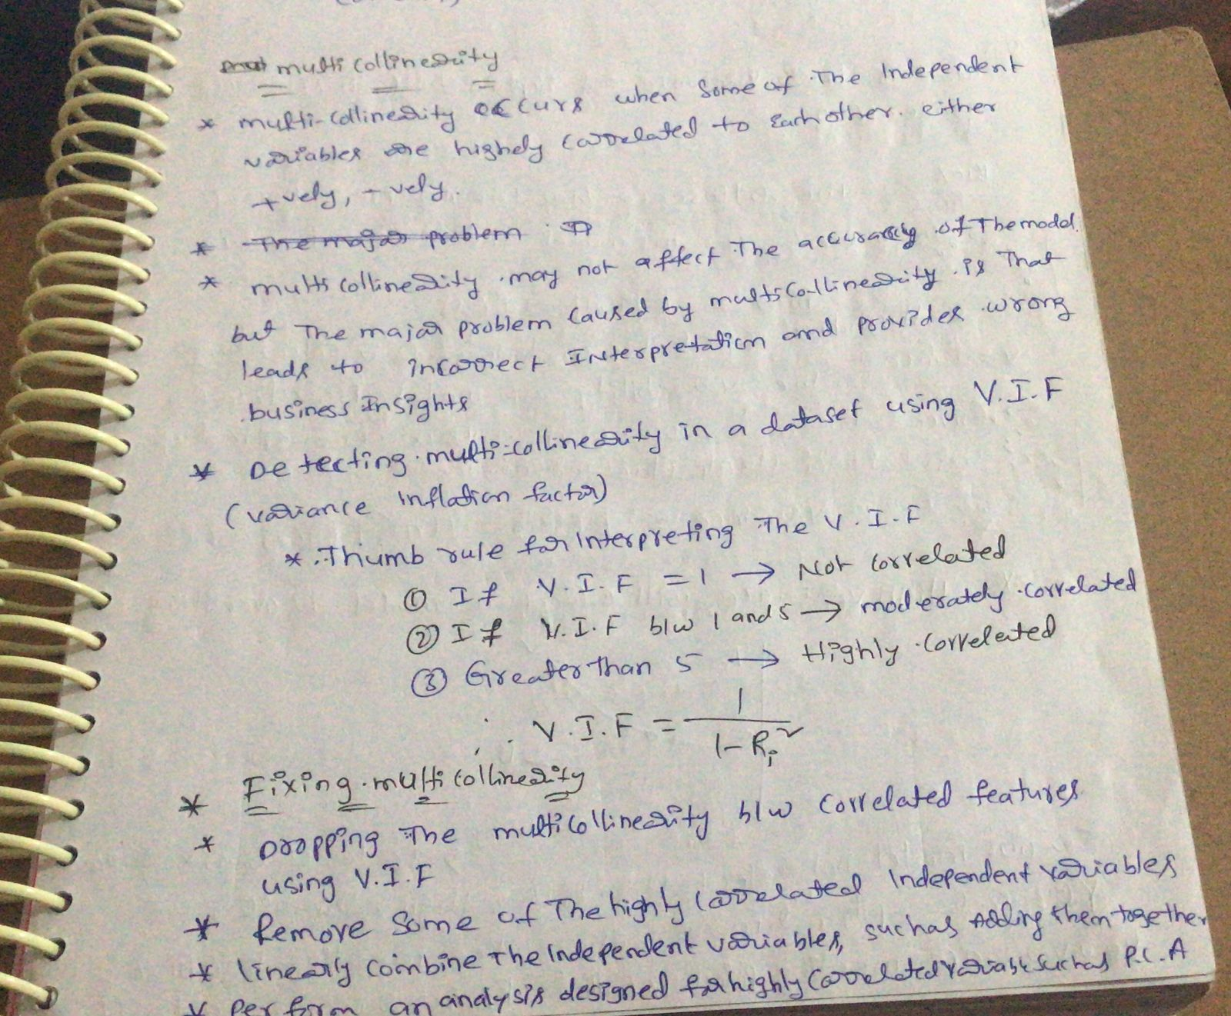

Slide 26
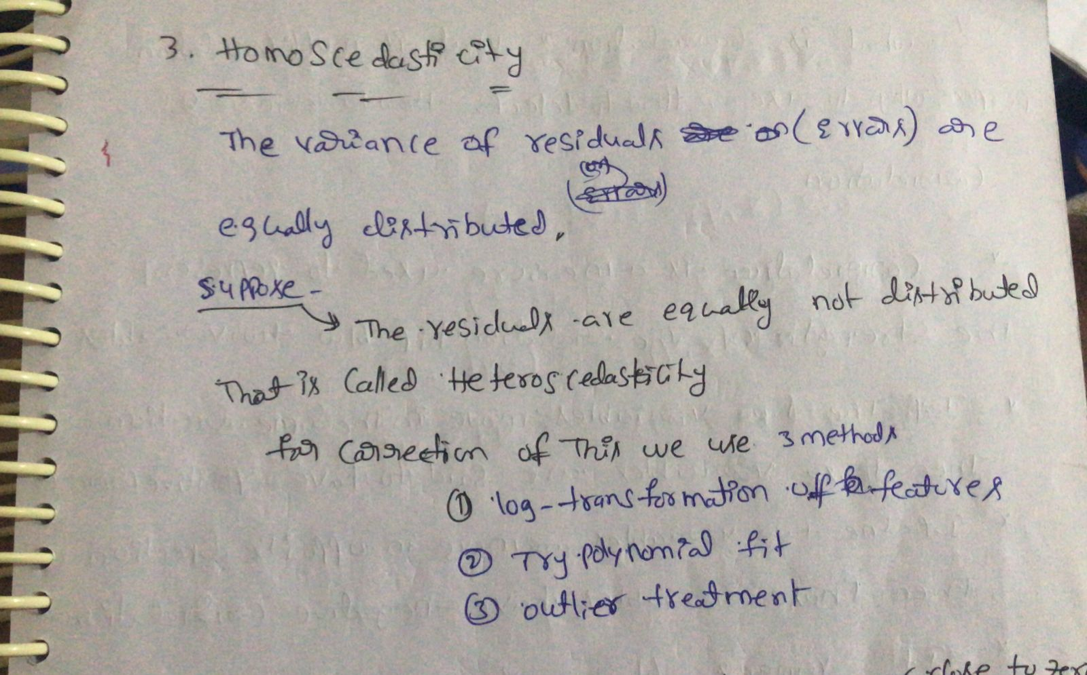
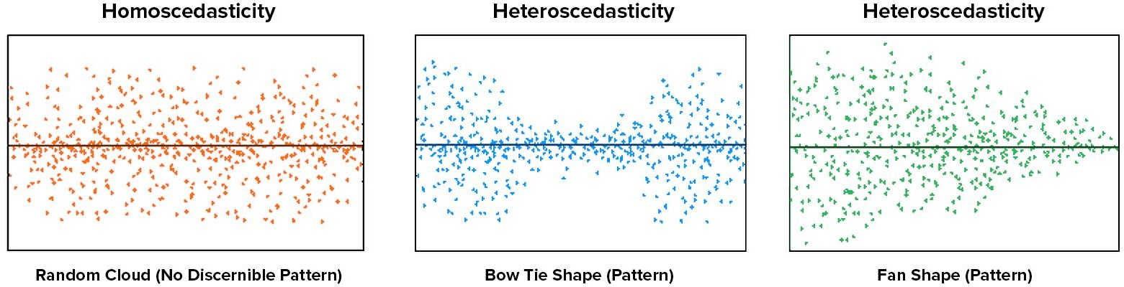

Slide 27
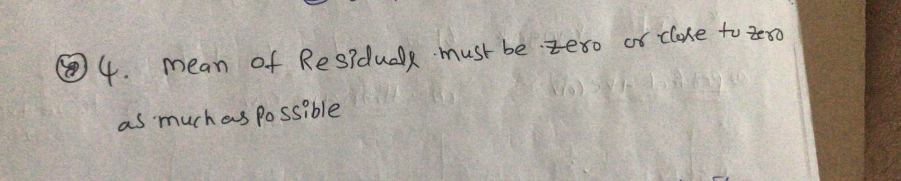

Slide 28
Properties of Regression Line
Regression line passes through the mean of independent variable (x) as well as mean of the dependent variable (y).
β_{p} explains the change in Y with a change in x by one unit. In other words, if we increase the value of ‘x’ it will result in a change in value of Y.
The regression constant (β₀) is equal to the y intercept of the regression line.
The line minimizes the sum of squared differences between observed values (the y values) and predicted values (the ŷ values computed from the regression equation).
5

Slide 29
Advantages of Linear Regression
Linear regression is simple to implement and easier to interpret the output coefﬁcients
When you know the relationship between the independent and dependent variable is linear, this algorithm is the best to use because it’s less complex as compared to other algorithms
It works well irrespective of data size
...

Slide 30
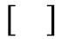
Limitations of Linear Regression
Outliers can have huge effect on the regression line.
Linear regression assumes a linear relationship between dependent and independent variables, which is not the case in most of the real world problems.
Prone to underﬁtting - Linear regression sometimes fails to capture the underneath pattern in data properly due to simplicity of the algorithm.
⊗

Slide 31
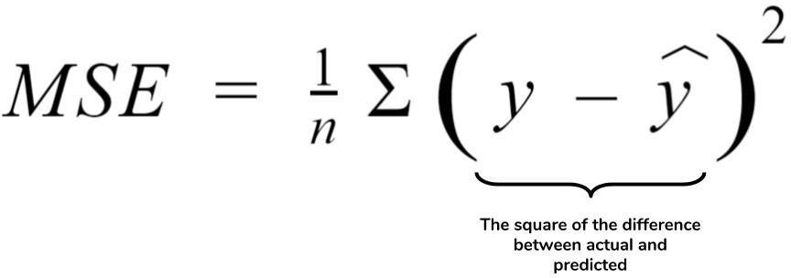
Regression Model Evaluation Metrics
1. Mean Squared Error (M S E)
MSE or Mean Squared Error is one of the most preferred metrics for regression tasks. It is simply the average of the squared difference between the target value and the value predicted by the regression model.

Slide 32
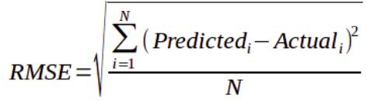
2.. Root Mean Squared Error (RMSE)
RMSE is the most widely used metric for regression tasks and is the square root of the averaged squared difference between the target value and the value predicted by the model. It is preferred more in some cases because the errors are ﬁrst squared before averaging which poses a high penalty on large errors.
5

Slide 33
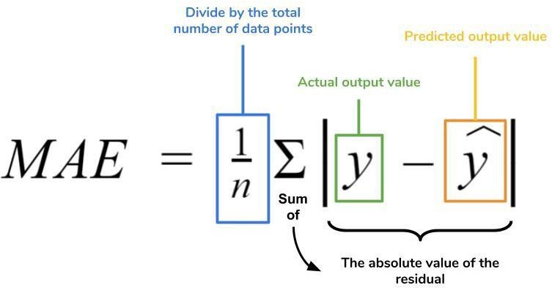
3. MAE (Mean Absolute Error)
MAE is the absolute difference between the target value and the value predicted by the model. The MAE is more robust to outliers and does not penalize the errors as extremely as MSE. MAE is a linear score which means all the individual differences are weighted equally.
It is not suitable for applications where you want to pay more attention to the outliers.

Slide 34
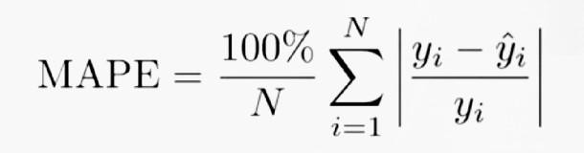
4. MAPE (Mean Absolute Percentage Error)
The mean absolute percentage error (MAPE), also known as mean absolute percentage deviation (MAPD), is a measure of prediction accuracy of a forecasting method in statistics, for example in trend estimation, also used as a loss function for regression problems in machine learning.

Slide 35
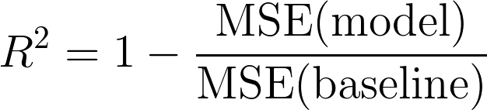
5. R² ( R – S quared)
Coefﬁcient of Determination or R² is another metric used for evaluating the performance of a regression model.
The metric helps us to compare our current model with a constant baseline and tells us how much our model is better.
The constant baseline is chosen by taking the mean of the data and drawing a line at the mean.
R² is a scale-free score that implies it doesn't matter whether the values are too large or too small, the R² will always be less than or equal to 1.

Slide 36
Properties of R²
R² ranges between 0* to 1.
R² of 0 means that there is no correlation between the dependent and the independent variable.
R² of 1 means the dependent variable can be predicted from the independent variable without any error.
An R² of 0.20 means that 20% variance in Y is predictable from X; an R² of 0.40 means that 40% variance is predictable.
*Note : R² score may range from -∞ to 1 if OLS is not used to get the predictions.

Slide 37
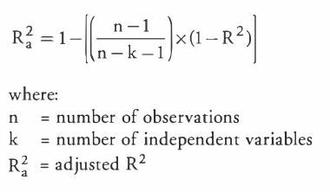
6. Adjusted R²
Adjusted R² depicts the same meaning as R² but is an improvement of it. R² suffers from the problem that the scores improve on increasing terms even though the model is not improving which may misguide the researcher.
Adjusted R² is always lower than R² as it adjusts for the increasing predictors and only shows improvement if there is a real improvement

Slide 38
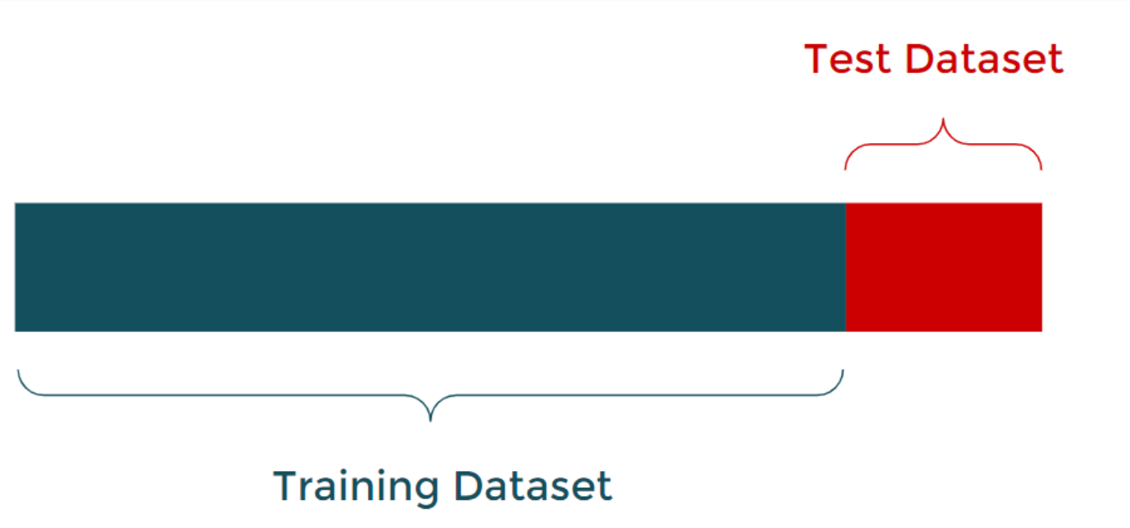
Understanding train and test data
The train-test split is a technique for evaluating the performance of a machine learning algorithm. It can be used for classification or regression problems and can be used for any supervised learning algorithm.
The procedure involves taking a dataset and dividing it into two subsets. The first subset is used to fit the model and is referred to as the training dataset. The second subset is not used to train the model; instead, the input element of the dataset is provided to the model, then predictions are made and compared to the expected values. This second dataset is referred to as the test dataset.
Train Dataset : Used to fit the machine learning model.
Test Dataset : Used to evaluate the fit machine learning model.
The objective is to estimate the performance of the machine learning model on new data: data not used to train the model. This is how we expect to use the model in practice. Namely, to fit it on available data with known inputs and outputs, then make predictions on new examples in the future where we do not have the expected output or target values.

Slide 39
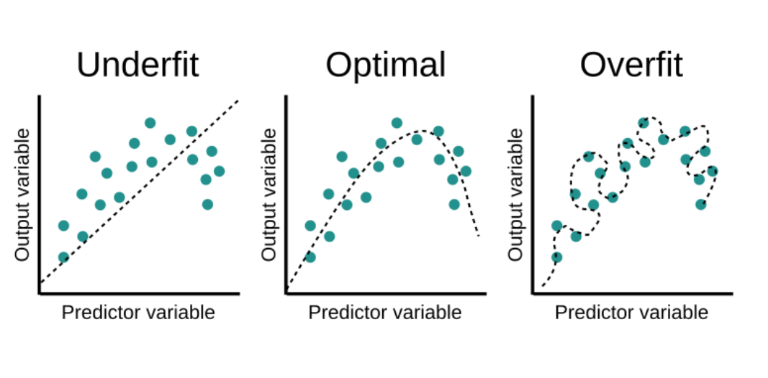
IF WE ARE NOT TRAIN OUR MODEL PROPERLY IT MIGHT BE UNDERFIT AND OVERFIT

Slide 40
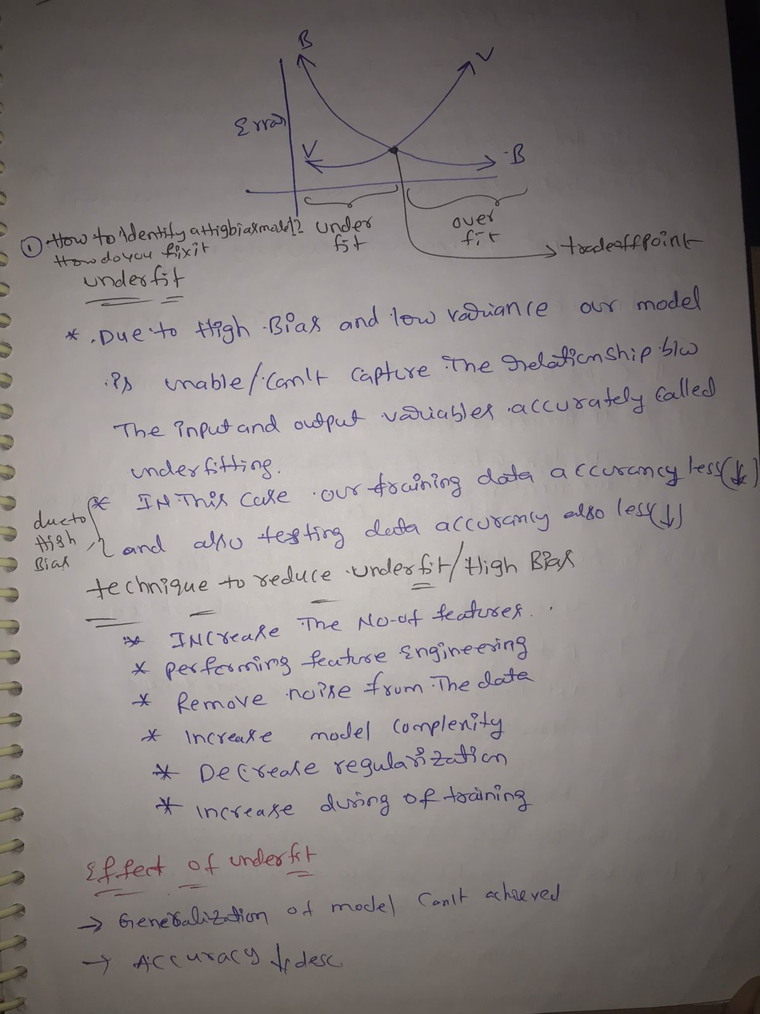

Slide 41
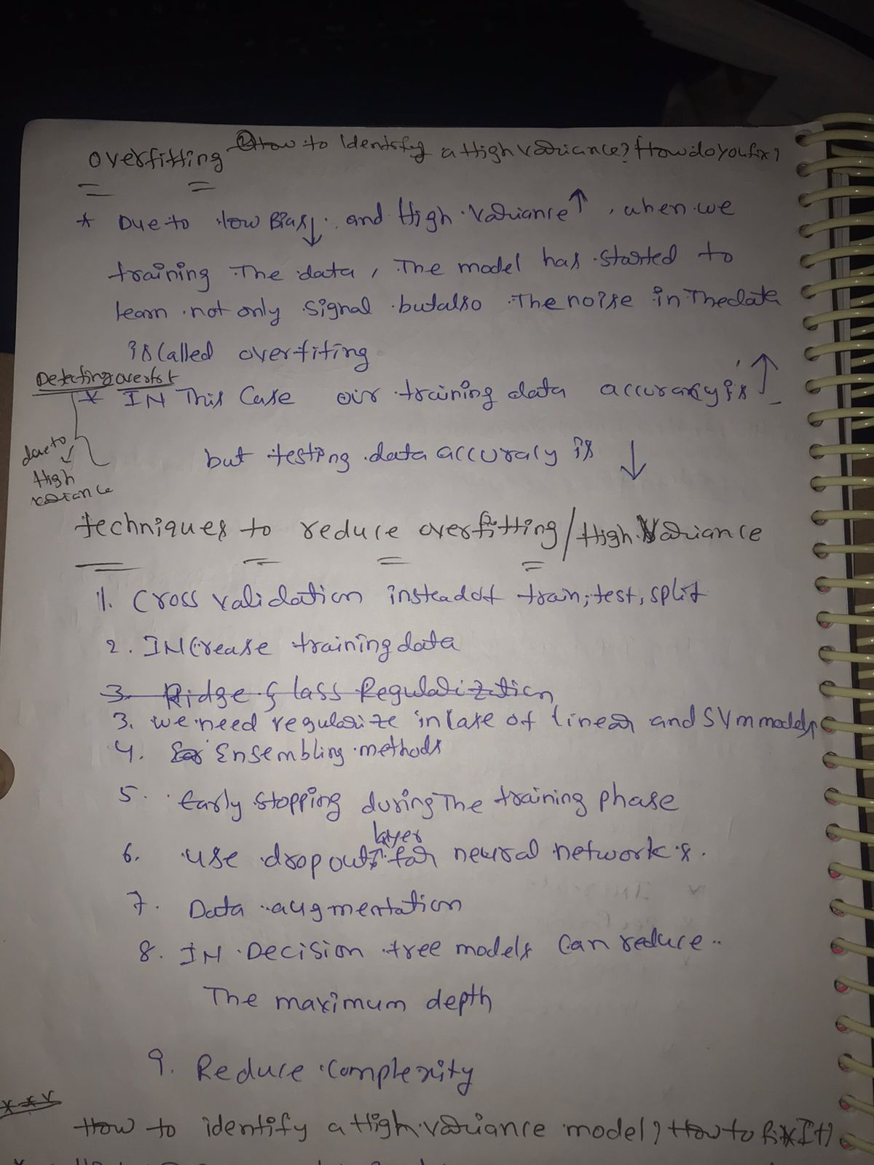

Slide 42
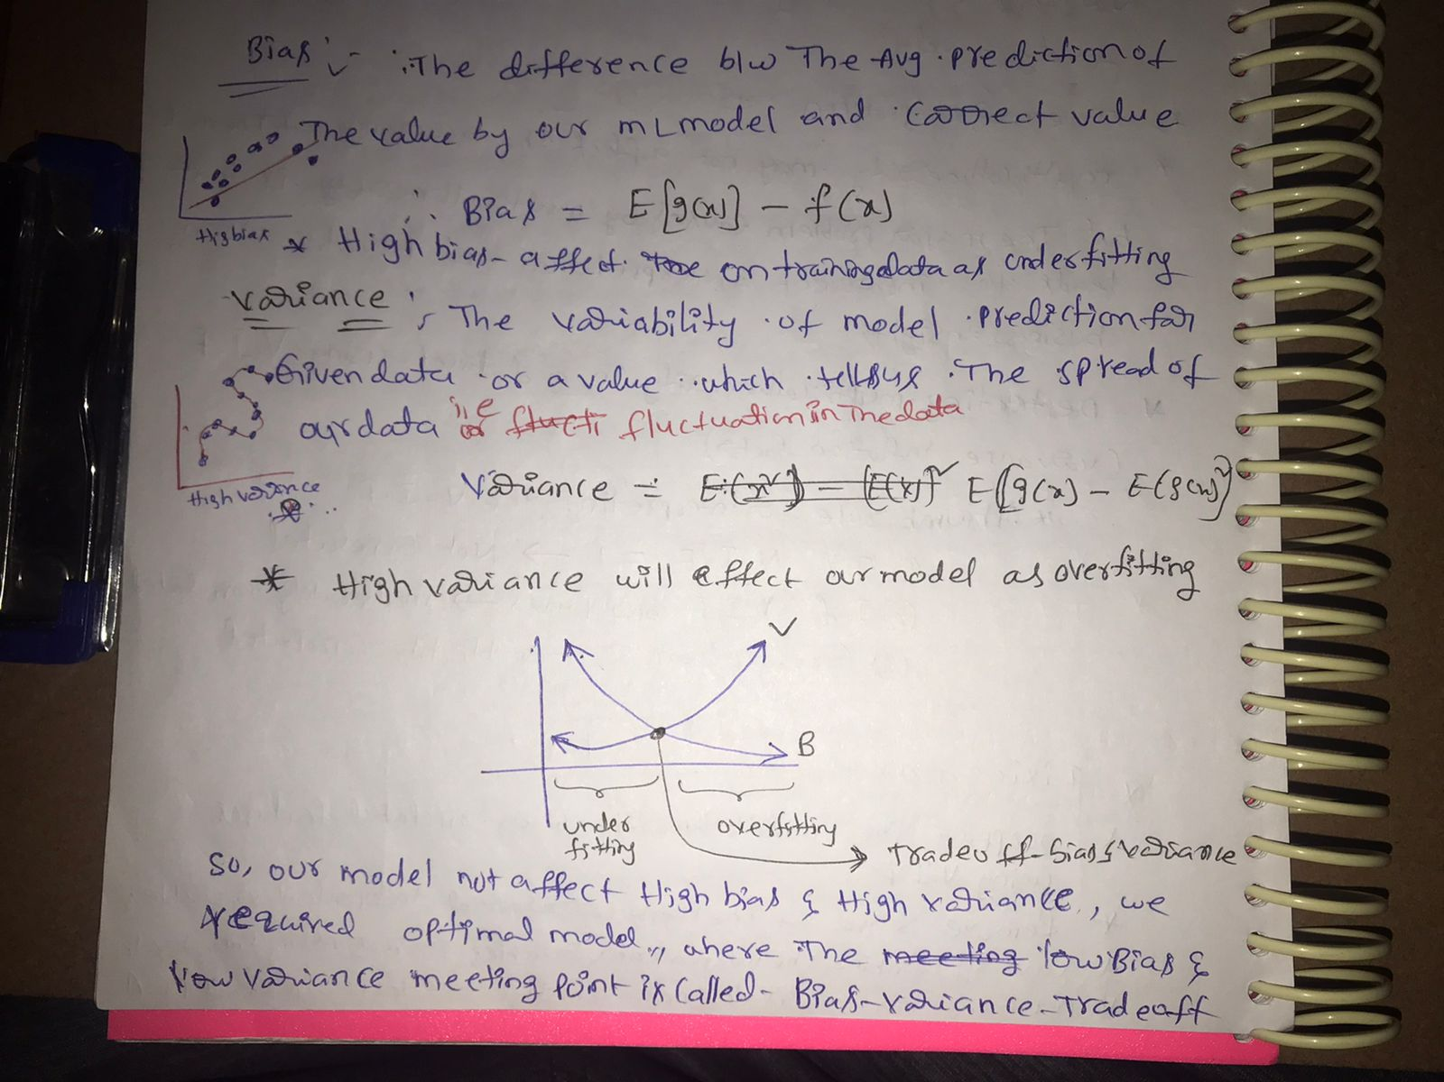

Slide 43
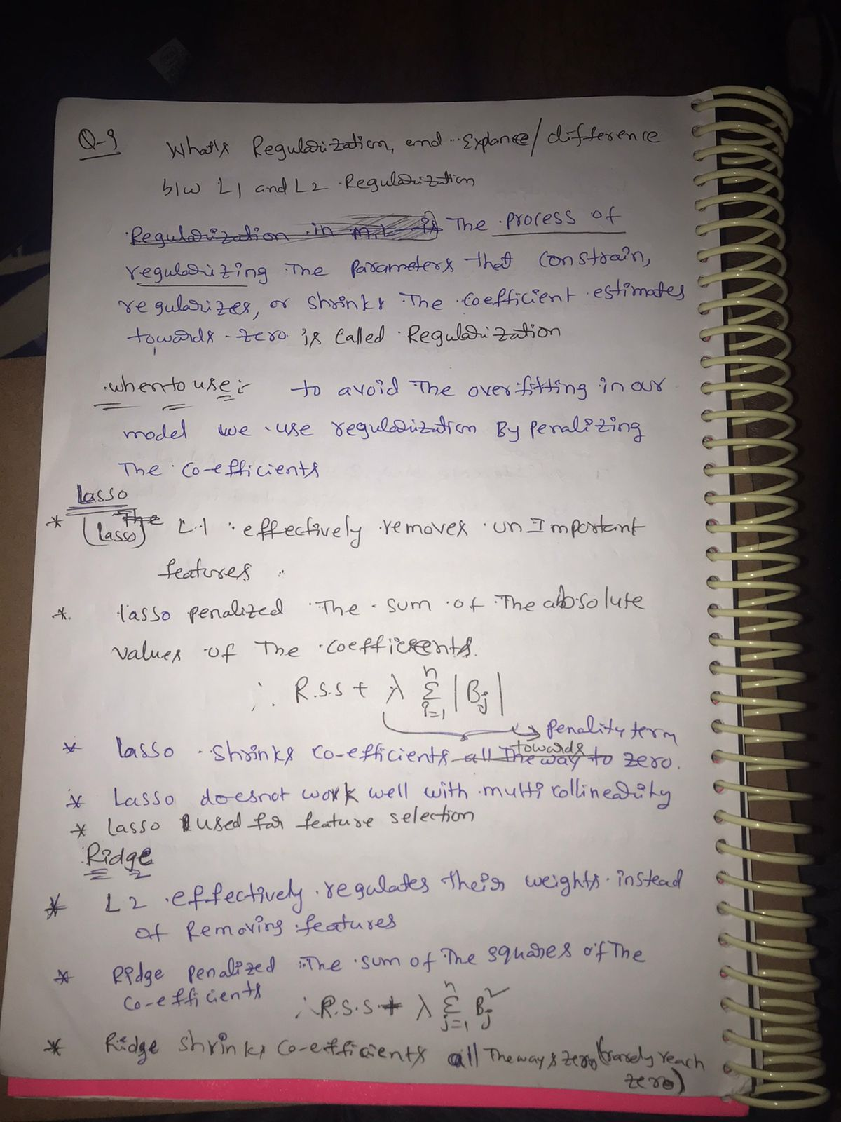

Slide 44
LINEAR COMPLETED

Slide 45
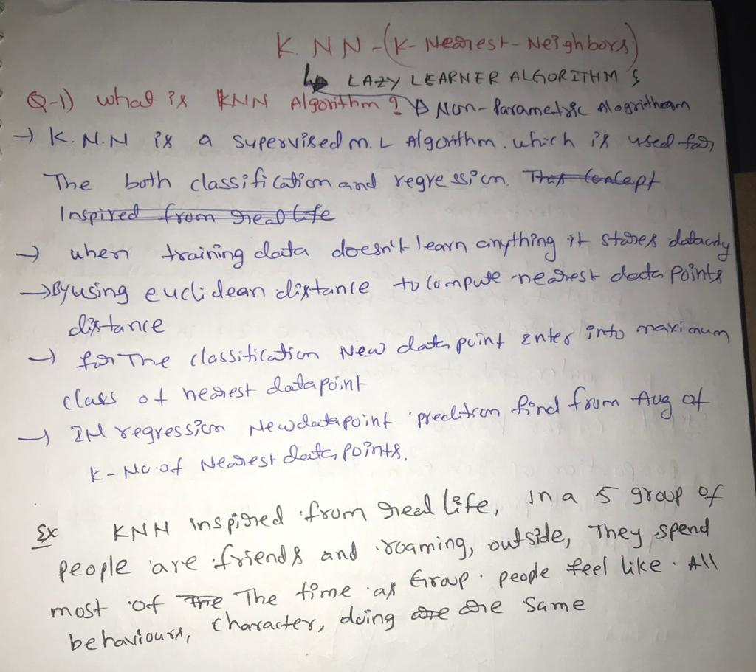
K-NN Algorithm

Slide 46
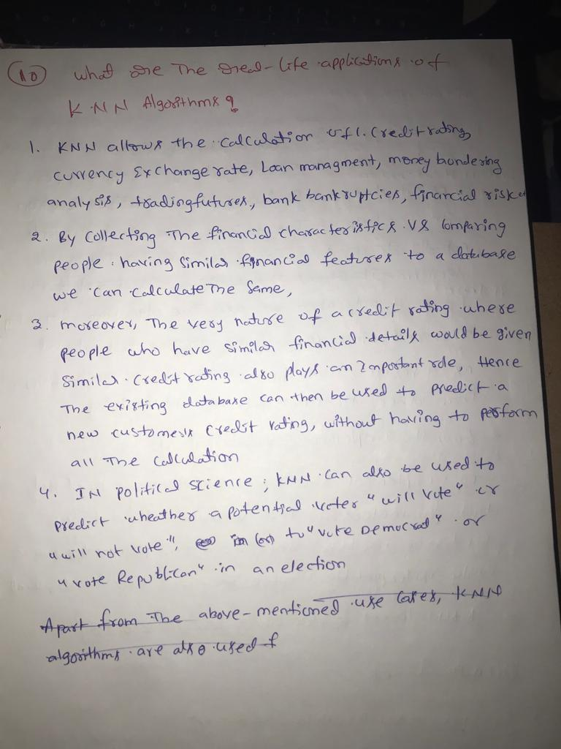

Slide 47
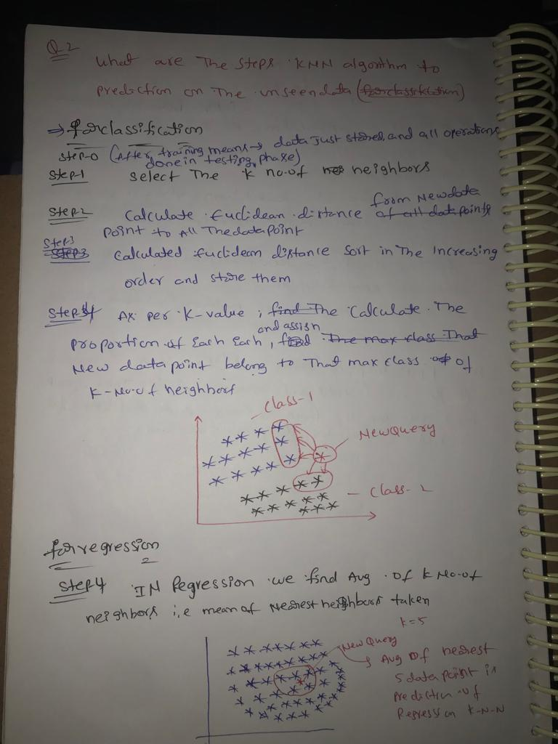

Slide 48
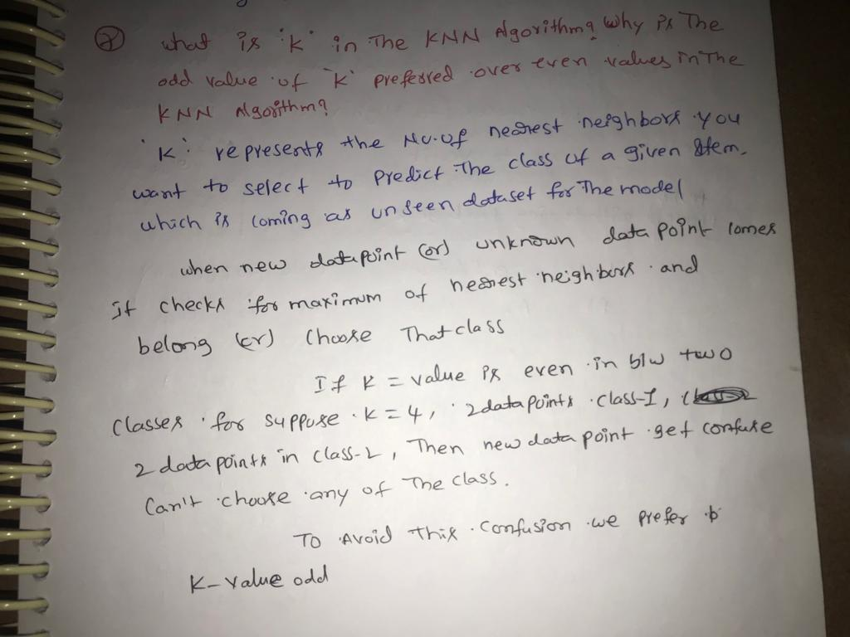

Slide 49
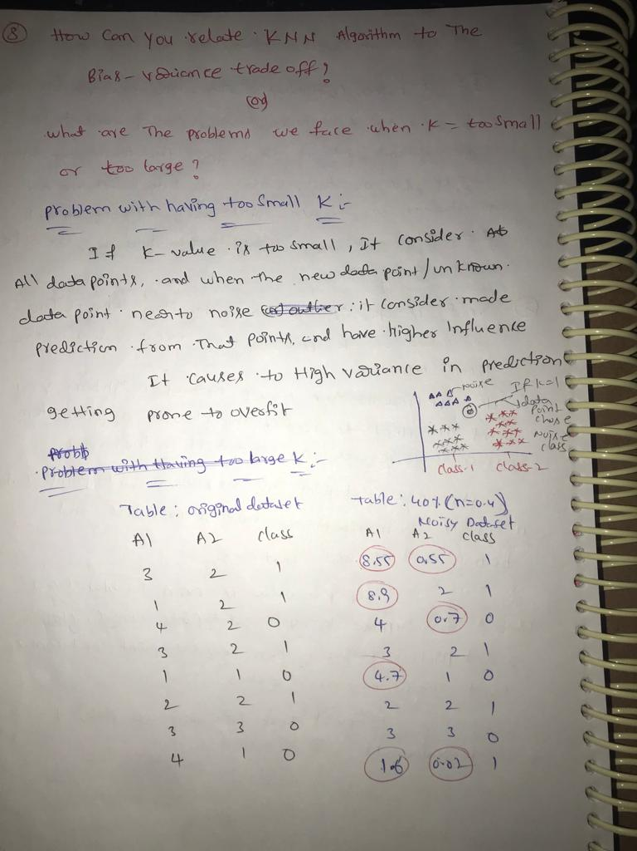

Slide 50
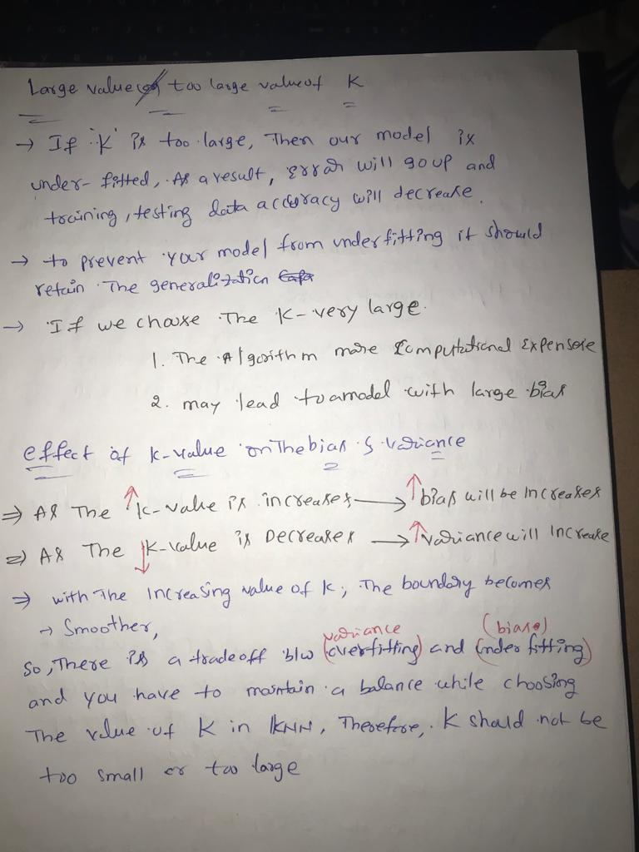

Slide 51
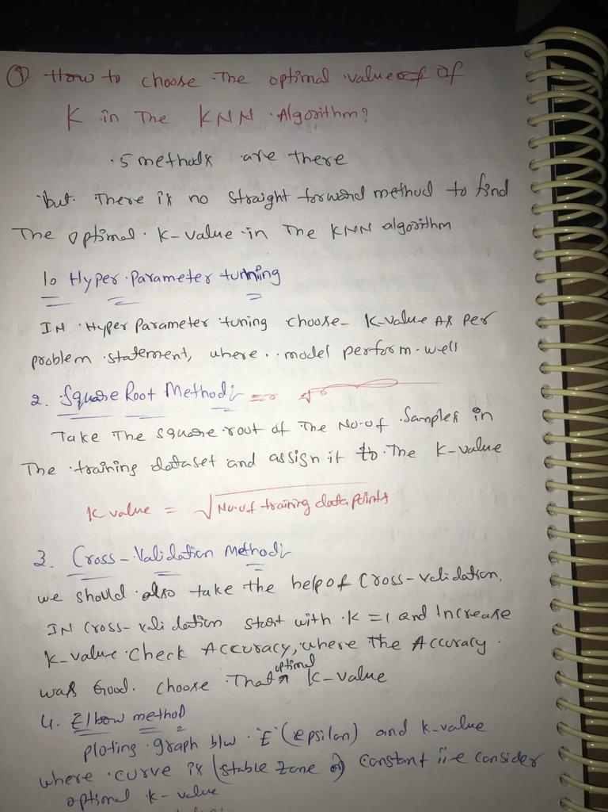

Slide 52
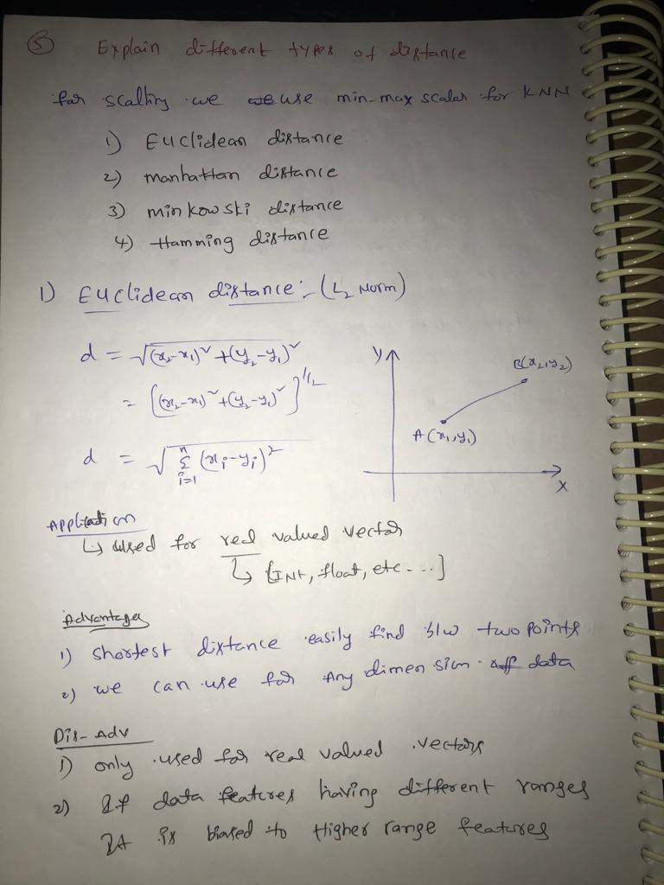

Slide 53
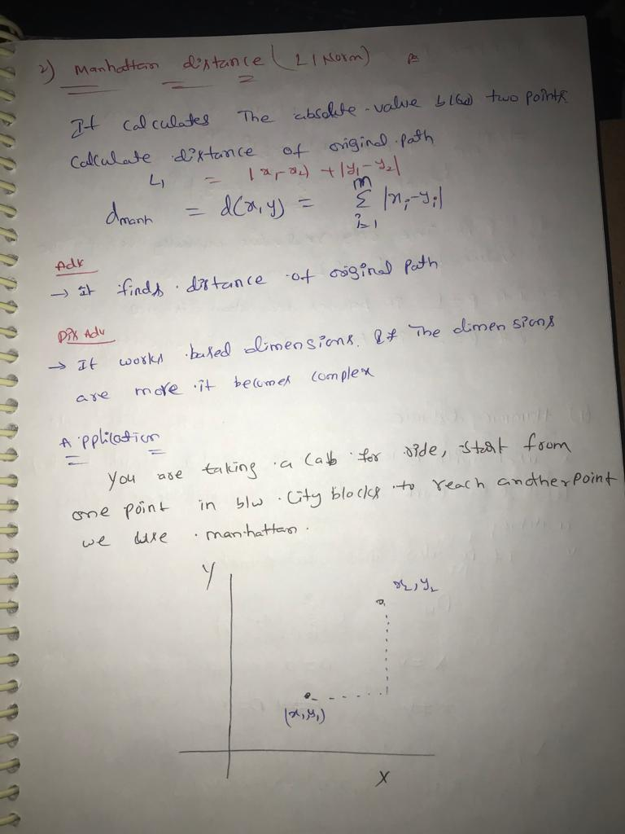

Slide 54
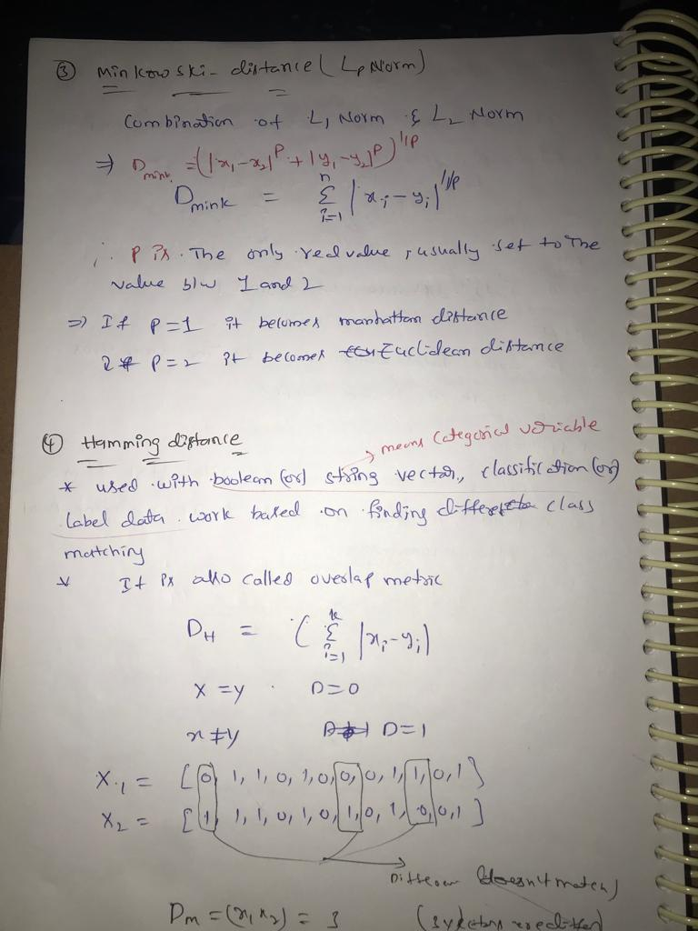

Slide 55


Slide 56

HOW BACK END WORKING KNN Algorithm
So we need to find of underweight class or normal class

Slide 57


Slide 58


Slide 59


Slide 60


Slide 61


Slide 62


Slide 63


Slide 64

END OF KNN

Slide 65


Slide 66


Slide 67


Slide 68


Slide 69


Slide 70


Slide 71
DEEP LEARNING

